Slide 1

The Battle of Neighbourhoods
Applied data science capstone by IBM on coursera
(Manideep Sadineni)

Slide 2
Introduction: Business Problem
With a population just short of 3 million people, the city of Toronto is the largest in Canada, and one of the largest in North America . Toronto is also one of the most multicultural cities in the world, making life in Toronto a wonderful multicultural experience for all. Toronto is well known for its great food.
The objective of this project is to find the best neighbourhood in Toronto to open a restaurant using Foursquare location data. In this project we’ll go through the solution for this problem for avoiding or considering low risk criteria and high success rate.

Slide 3
Data description
For this project we need the following data: 1. Toronto City data that contains Borough, Neighbourhoods along with their latitudes and longitudes
Data Source: https://en.wikipedia.org/wiki/List_of_postal_codes_of_Canada:_M
Description: This Wikipedia page contain all the information we need to explore and cluster the neighbourhoods in Toronto. We will be required to scrape the Wikipedia page and wrangle the data, clean it, and then read it into a panda’s data frame so that it is in a structured format like the Toronto dataset.

Slide 4
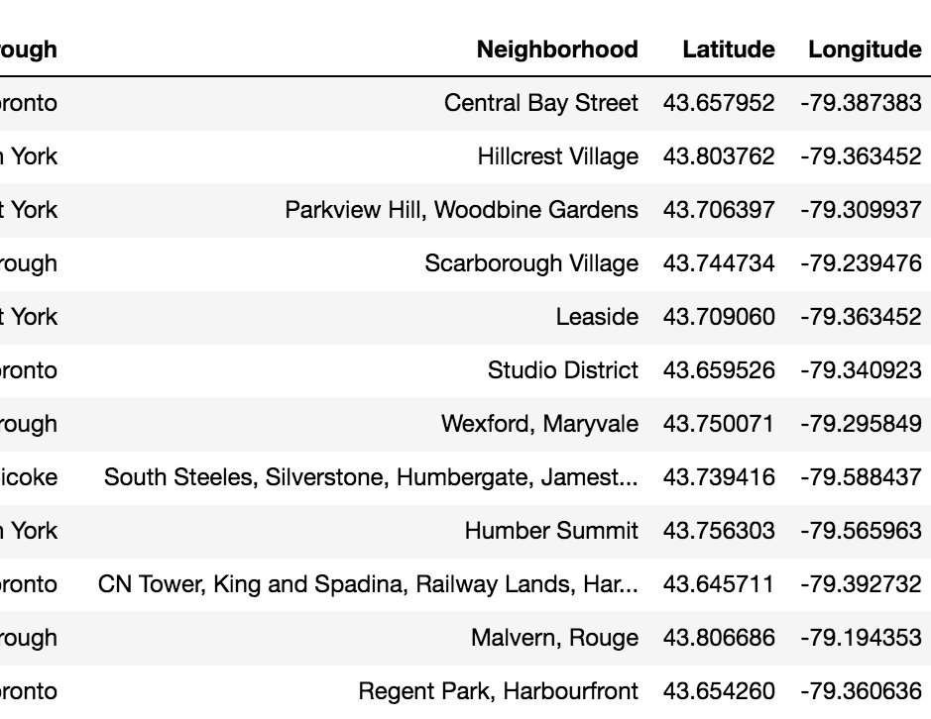
Neighborhood dataset of Toronto
2. Geographical Location data using Geocoder Package
Data Source: https://cocl.us/Geospatial_data
Description: The second source of data provided us with the Geographical coordinates of the neighborhoods with the respective Postal Codes.
3. Venue Data using Foursquare API
Data Source: https://foursquare.com/developers/apps
Description: From Foursquare API we can get the name, category, latitude, longitude for each venue.

Slide 5
Methodology
After scraping the data from Wikipedia there were Boroughs that were not assigned to any neighborhood therefore, the following assumptions were made:
Only process the cells that have an assigned borough. Ignore cells with a borough that is Not assigned.
More than one neighborhood can exist in one postal code area. For example, in the table on the Wikipedia page, you will notice that M5A is listed twice and has two neighborhoods: Arboriform and Regent Park. These two rows will be combined into one row with the neighborhoods separated with a comma as shown in row 11 in the above table.
If a cell has a borough but a Not assigned neighborhood, then the neighborhood will be the same as the borough.
We will merge the two tables together based on Postal Code using the Latitude and Longitude collected from the Geocoder package.

Slide 6
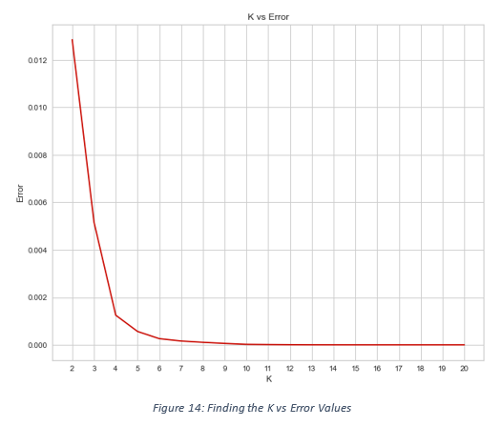
K-Means Clustering
Now we’ll cluster these neighborhoods based on the frequency of Italian restaurants present. To do this we apply k-means clustering algorithm. To avoid the overfitting and underfitting of the model we need an optimum value of “k”. There are many techniques like Elbow method, Silhouette score method to get the best “k” value. Here we’re going to use Elbow method to get best “k” value. We’ll import ‘K Elbow Visualizer’ from the yellow brick package. Then we fit our K-Means model above to the Elbow visualizer.
K-Means Clustering

Slide 7
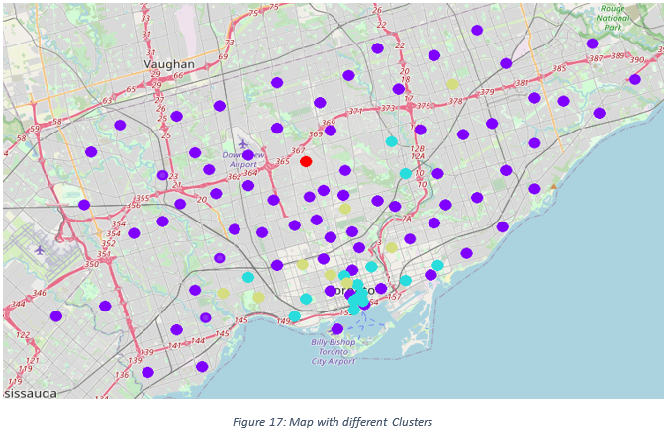
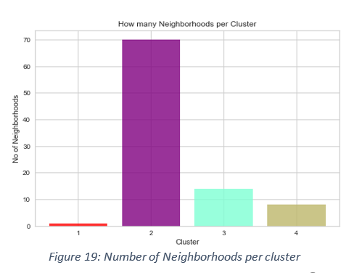
Result & Outcomes

